Slide 1
Packet Sniffers
Lecture 10 - NETW4006
NETW4006-Lecture09

Slide 2
Content
Definition
Sniffer Capabilities
How does it work?
When does it work?
Preventing Sniffing
Detection of Sniffing
References
NETW4006-Lecture09

Slide 3
Definition
Packet sniffing: act of capturing data packets flowing across network.
The sniffer is a program/device that monitor data travelling over a network.
  legitimate uses to monitor network performance or troubleshoot problems: network audit, demonstrate insecurity of plaintext network protocols
  Also used by hackers and crackers to gather information illegally about networks they intend to break into: passwords, IP addresses, credit card numbers, protocols being used on the network and other information (binary data into something intelligible) that will help the attacker infiltrate the network.
NETW4006-Lecture09

Slide 4
Sniffer Capabilities
Watch all network traffic over any Network Interface Card (NIC) connected to the host machine: TCP, IP, UDP, ICMP, ARP, RARP. Also port specific traffic: http, ftp, telnet,…
Forging ARP replies: intercept packets from target host(s) on the LAN intended for another host on the LAN: effective way of sniffing traffic on a switch
Passive sniffing: determine the local gateway of an unknown network – Data link layer (Hub)
Active Sniffing-Flood local network with random MAC addresses: switches will fail open in repeating mode, facilitating sniffing). This is no longer passive sniffing (Switch)
Password sniffing: minimally parsing each application protocol, and saving the "interesting" pieces
Sniffing HTTP traffic: output all requested URLs and do offline log analysis
Capture URLs from a client to local web browser for display URL, updated in real-time: when the target surfs, the local browser surfs
NETW4006-Lecture09
Notes:
Hub transmits line data to each port on the machine and has no line mapping. Switch looks at the MAC address associates with each frame passing through it and sends the data to the required port.
RARP – Reverse Address Resolution Protocol

Slide 5
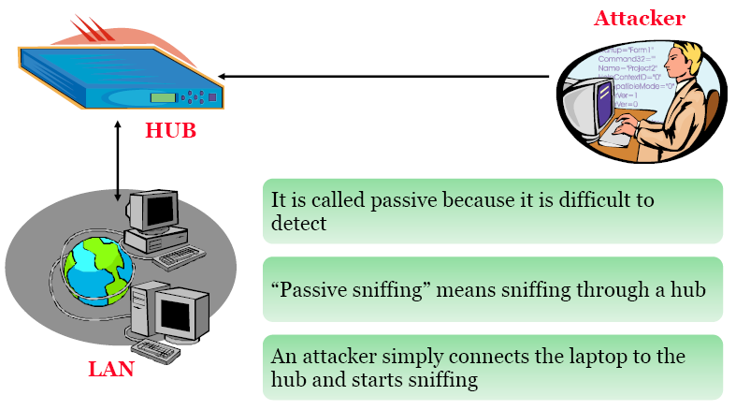
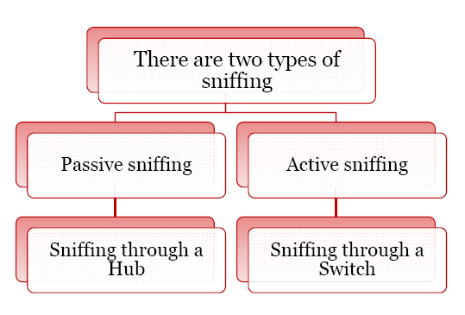
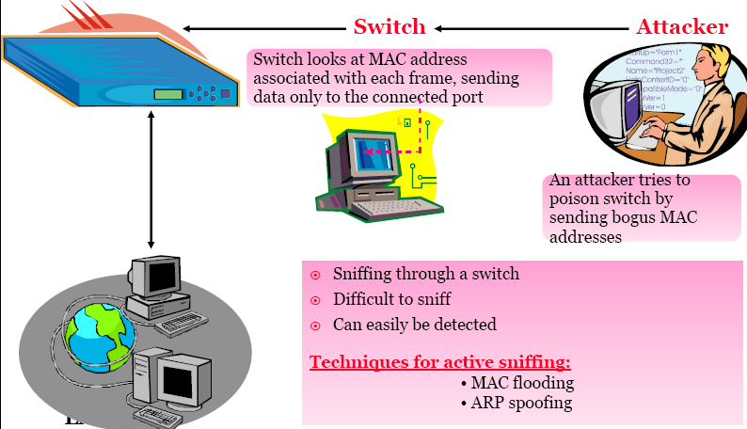
NETW4006-Lecture09

Slide 6
How Does a Sniffer Work ?
Packet sniffer must be on the same network as the originating or intended destination machine
Remote sniffing: install some Trojan or backdoor program on one of the computers on either the sending or receiving networks they may be able to do the packet sniffing remotely
Trojan: malicious program disguised as a normal application (perform a desirable function for the user prior to run or install but steals information or harms the system)
Backdoor: secret or undocumented means of getting into a computer system(is a method of bypassing normal authentication)
NETW4006-Lecture09

Slide 7
How Sniffer Works ? (1)
Most common way of networking computers – Ethernet
Computer connected to LAN has two addresses – MAC Address(uniqly identifies each node in a network & stored on Network card ), MAC is used by Ethernet protocol while building frames to transfer data to an from a system
IP Address – used by applications.
Data Link Layer uses an Ethernet header with the MAC address of the destination machine rather than IP address. The Network Layer is responsible for mapping IP network address to the MAC address as required by Data Link protocol.
It initially looks for the MAC addresses of the destination machine in a table- called as ARP cache
NETW4006-Lecture09

Slide 8
If no entry if found for the IP address, an ARP broadcast of a request packet goes out to all machines on the local sub-network.
The machine with that particular address responds to the source machine with its MAC address. This MAC address then gets added to the source machine ARP cache.
The source machine, in all its communication with the destination machine uses this MAC.
NETW4006-Lecture09

Slide 9
Preventing Sniffing
Prevention: which network services send data in the plain text ? default /old POP, SMTP, FTP, Telnet, News clients, ICQ, MSN and AOL Instant messengers send passwords in clear text
When logging into e-mail services check if encrypted login is supported.
Even if you login securely any e-mail you send is still in clear text, anyone on the path that the e-mail travels through can technically read it
  Use Encryption to encrypt the message so that no one on the path to the destination can read: Pretty Goof Privacy (http://www.pgpi.org)
When shopping on-line make sure the store has a "secure" connection for submitting credit card details:
  standard SSL 128bit encryption (http://wp.netscape.com/eng/ssl3/draft302.txt and TLS RFC 2246 and previous lecture and lab)
Telnet sends password and normal data in plain text:
  SSH encrypts connection (RFC 4251 to RFC 4254 and previous lecture and lab)
If possible use a Switch rather than a HUB on a LAN: efficient protection in practice (more work required to successfully sniff)
NETW4006-Lecture09

Slide 10
Indication/Detection of Sniffing
Indication
  Difficult to detect that a packet sniffer is sniffing a connection: passive act (the data is "logged" but unaltered). Would require physically checking all your Ethernet connections by walking around, and observing the output of ifconfig -a !!!
  A major clue: many DNS lookup are taking place could mean the sniffer is attempting to convert IP addresses to host names
  A stronger method of detecting packet sniffing: send an ARP request to the device in question to determine if promiscuous mode: in most cases assumption that it is the network card of the computer running the sniffer
  Defence against sniffing is not really prevention but rather providing security solutions so that even if large amounts of data is sniffed, not much use can be made out of it. This is the major reason behind one-time passwords and encryption
NETW4006-Lecture09

Slide 11
Indication/Detection of Sniffing
The DNS Test
  Detection tool itself is in promiscuous mode. Create numerous fake TCP connections on same network segment, expecting a poorly written sniffer picks up on those connections and resolve the IP addresses of the nonexistent hosts.
  Packet sniffers can perform reverse DNS lookups for the captured packets. When reverse DNS lookup occurs, a detection tool sniffs (promiscuous mode) the lookup request to see if the target is the one requesting resolution of that nonexistent host
The Ping Test
  Construct an ICMP echo request with: IP @ of the suspected sniffing machine + mismatched MAC @.
  Most systems should disregard this packet because bad MAC @. Some Linux, NetBSD and NT systems, when the NIC is in promiscuous, the sniffer collects as a legitimate packet and respond. Clever attackers make that sniffer does not answer such packets
NETW4006-Lecture09

Slide 12
Indication/Detection of Sniffing
The ICMP Ping Latency Test
  Ping the target and note the Round Trip Time (RTT) + create hundreds of fake TCP connections on our network segment at a lightning rate. Then observe if the target machine's network latency increases
The ARP Test
  Send an ARP request to target with a bogus destination MAC @. A machine in promiscuous mode would reply
NETW4006-Lecture09

Slide 13
Open Source Sniffers
tcpdump: “grand-father” of packet sniffers: by default on Linux. We are going to use it during the Lab. (See the manual)
Ethereal (now Wireshark http://www.wireshark.org/) excellent GUI based sniffer. Good protocol details.
hunt: sniffer including some attack tools. http://www.packetstormsecurity.org/sniffers/hunt/
Ettercap: sniffer for switched LANs: ARP poisoning and the man-in-the-middle technique to sniff all the connections between two hosts. It can inject characters to server (emulating commands) or to client (emulating replies) while maintaining an established TCP connection. http://ettercap.sourceforge.net
dsniff: records observed usernames and passwords from various known protocols
tcpflow: records TCP stream payloads
NETW4006-Lecture09

